Slide 1



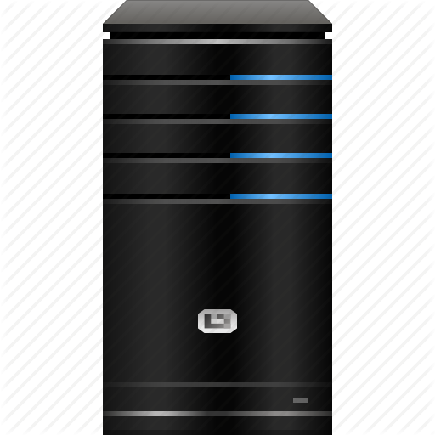

State Management
Cookies, Sessions
State Management
SoftUni Team
Technical Trainers
Software University
http://softuni.bg

Slide 2


Table of Contents
Cookies
Sessions

Slide 3
Have a Question?
sli.do #CSharpWeb

Slide 4

Cookies

Slide 5


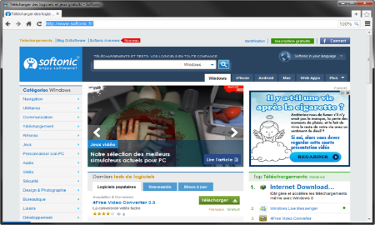



HTTP is Stateless
it doesn’t store information about the requests
Web Client
Web Application
GET
POST
GET
Not stored

Slide 6
What are Cookies?
A small file that web applications embeds on the user's computer
http://www.oracle.com/
Web Client
Web Application
GET www.example.bg HTTP/1.1
HTTP/1.1 200 OK Set-Cookie: lang=en
GET www.example.bg HTTP/1.1 Cookie: lang=en

Slide 7
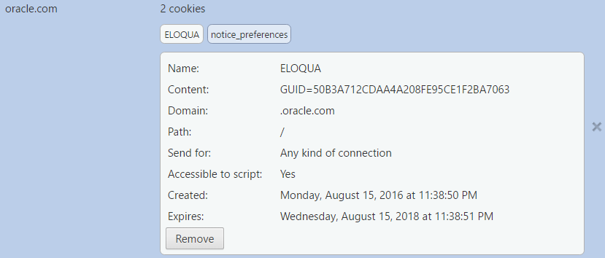
Cookie Example
Name
Value
Host
Is secured?
HTTP only
Created on
Expires on

Slide 8




Cookie Purpose
Cookie
Language settings
Preferences (Remember sign in)
Store
Session

Slide 9
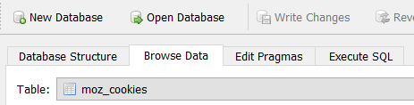
Examine your Cookies
Most cookies are stored in a RDBMS, usually SQLite
Download SQLite browser from here
In Mozilla cookies are located here:
Open the file with the sqlite browser
C:\Users\{username}\AppData\Roaming\Mozilla\Firefox\Profiles\2awcekaj.default\cookies.sqlite

Slide 10
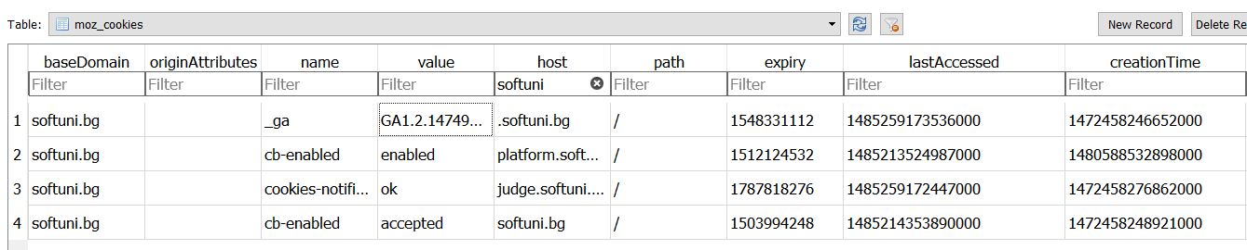
Examine your Cookies (2)
Name
Host
Created on
Value
Last accessed on

Slide 11

Third Party Cookies
Cookies stored by an external party
http://stackoverflow.com/
Web Application
Web Client
Cookie transfer
Cookie transfer
Third Party

Slide 12
Custom-made Cookie
HTTP Variable
Environment.GetEnvironmentVariable("HTTP_COOKIE");
Example of a Cookie class
public class Cookie
{
public Cookie(string name, string value)
{this.Name = name; this.Value = value;}
public string Name { get; private set; }
public string Value { get; private set; }
public override string ToString()
=> $"{this.Name}={this.Value}";
}

Slide 13

Sessions

Slide 14

What are Sessions?
A session is a way to store information to be used across multiple pages
/login
Web Application
Session
/home
user: Teo
/products

Slide 15
Relation with Cookies
Session Store
sid 5 { uid: 101 }
sid 7 { uid: 102 }
Cookie {
name: sid value: 5
}
Validate
Req
Web Application
Session
Resp
Database
Cookie {
name: sid value: 7
}
Req
Get data
uid name 101 Teo
102 Bojo
Resp
Create personal web page

Slide 16
Custom-made Session
Session.cs
public class Session {
private long id;
private Dicitionary<string, string> pairs;
Unique id
Key-value pairs

Slide 17

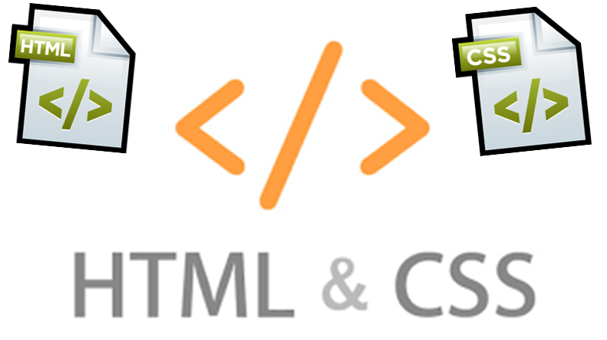
Summary
Cookies are client based stored information
They are created by web applications
Browser sends them back to the application
Sessions are server based information that is used across multiple pages

Slide 18








Web Development Basics – Course Overview
https://softuni.bg/courses/

Slide 19
License
This course (slides, examples, demos, videos, homework, etc.) is licensed under the "Creative Commons Attribution-NonCommercial-ShareAlike 4.0 International" license

Slide 20






Free Trainings @ Software University
Software University Foundation – softuni.org
Software University – High-Quality Education, Profession and Job for Software Developers
softuni.bg
Software University @ Facebook
facebook.com/SoftwareUniversity
Software University @ YouTube
youtube.com/SoftwareUniversity
Software University Forums – forum.softuni.bg

